Slide 1

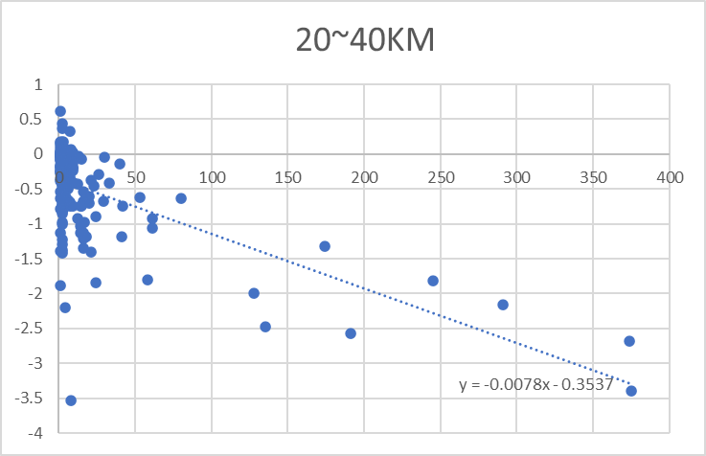
S/W Operation Scenario : UI
Vehicle Speed : 0km/h, 10~30km/h, 40~60km/h
Driving Load : None(0kg), >150kg
Drive Distance : 1,234km
Raw-Data Display
in Time-domain
(Speed, Angle, Torque)
Vehicle Loading :
None >150kg
Continue / Pause
Save & End
Run / Stop
0km/h
10~30km/h
40~60km/h
Linearity = **.*%
Linearity = **.*%
Linearity = **.*%
1

Slide 2
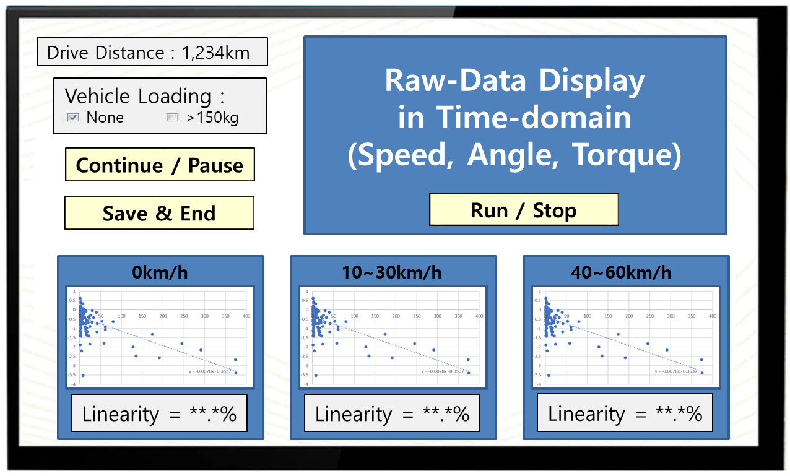
Configuration Options
Using ”Config.txt” File
message=distance
loading=0
speed=10-30
linearity=0.93
output=linearity
saved=none
threshold=-60
Message option
: distance or date
Loading option
: 0 or 150
Speed classification option
: speed=10-30
Output option
: linearity or assist_torque
Saved option(loading of previously saved data or not)
: none or saved03.txt
Linearity Measurement Error@Project : <15%(±7.5%)
Vaild threshold option(7p) : 0~-99
2

Slide 3
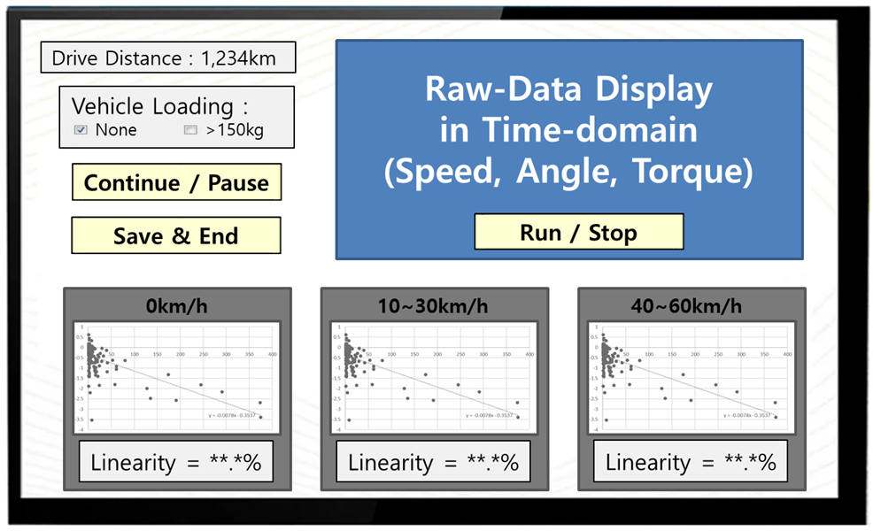
Manual Options
Button Activation After Initialization
Data-mining debugging
& system operation check
Activation
after initialization
Pause@parking
S/W shutdown
in case of power shortage
3

Slide 4
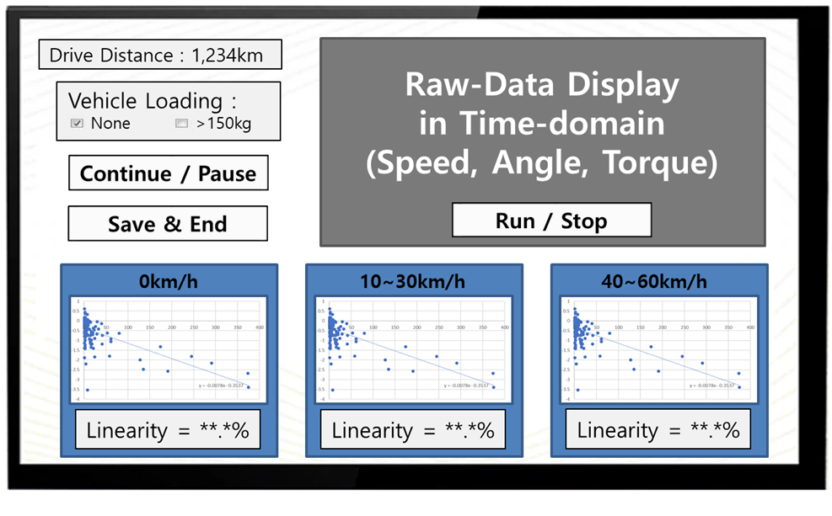
Data Processing
From raw-data to plot
Pre-processing
: Filtering of abnomal signals, DC removal
Classification by vehicle speed
: 0~10km/h, 10~30km/h, 30~60km/h
Removal of invalid data
: Valid@Δangle<-60 vs. invalid@Δangle>-60
Interval segmentation & calculation of interval & data-integration
: integration data : angle, torque
Plot of integration data(+removal of outlier data)
: x=interval, y=(∫torque)/(∫angle)
Calculate output(linearity or assist torque)
Activation
after >10km-driving(?)
X
Y
4

Slide 5
Data Processing
From raw-data to plot
Pre-processing : Filtering of abnomal signals(& high freq. noise), DC removal
Input
Output
SPD
SPD
Filtering
ANG
ANG
Filtering
TRQ
TRQ
Filtering
DC removal
5

Slide 6
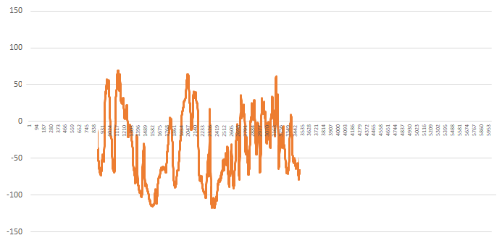
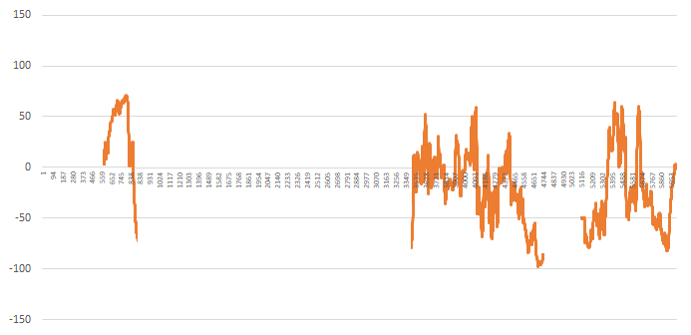
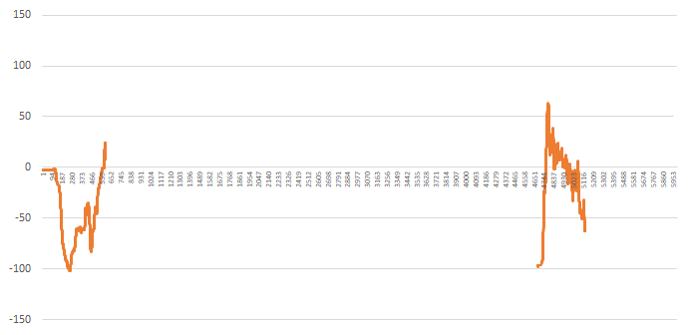
Data Processing
From raw-data to plot
Classification by vehicle speed : 0~10km/h, 10~30km/h, 30~60km/h
Input
Output
SPD
30~60km/h
30~60km/h
ANG
30~60km/h
10~30km/h
3개 구간
0~10km/h
ANG
10~30km/h
ANG
10~30km/h
TRQ
0~10km/h
ANG
0~10km/h
6
TRQ에 대해서도 SPD 3개 구간으로 구분 수행!

Slide 7
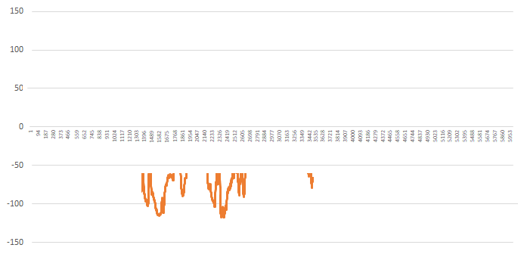
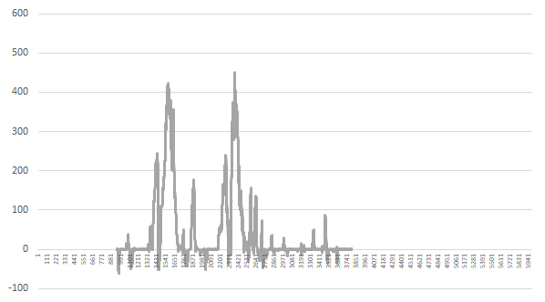
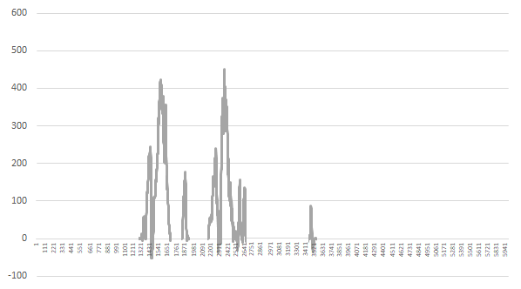
Data Processing
From raw-data to plot
Removal of invalid data : Valid@Δangle<-60 vs. invalid@Δangle>-60
Input
Output
30~60km/h
30~60km/h
ANG
ANG
Invalid
(removal)
-60
Valid
TRQ
TRQ
“Config.txt” option : 0~-99
7
0~10km/h, 10~30km/h SPD 구간에서도 수행!

Slide 8
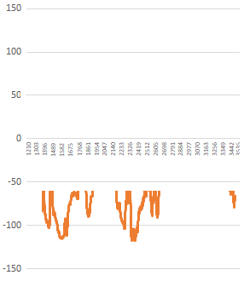
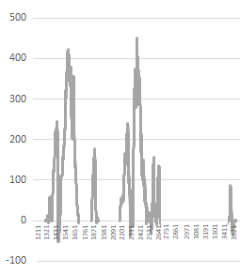
Data Processing
From raw-data to plot
Interval segmentation & calculation of interval & data-integration : angle, torque
30~60km/h
ANG
TRQ
∫torque@⑤
Interval@①
Interval@②
Interval@⑧
⑥
⑦
⑧
⑥
⑦
⑧
②
⑤
①
③
④
①
③
④
②
⑤
∫angle@②
예시에서 ①~⑧의 8개 segmentation 존재
각각의 segmentation에 대해 interval 길이, angle 적분, torque 적분 계산
0~10km/h, 10~30km/h SPD 구간에서도 수행!
8

Slide 9
Appendix

Slide 10
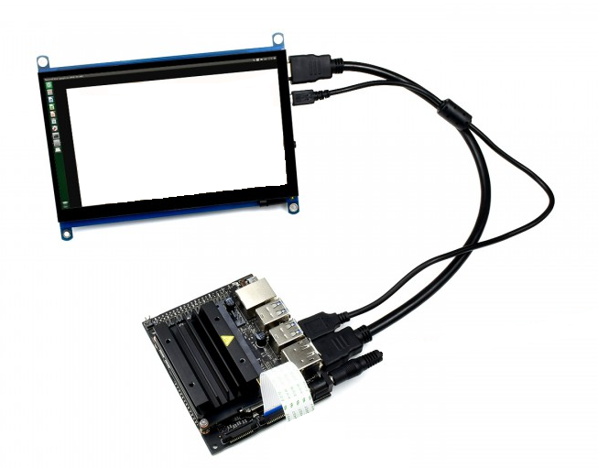
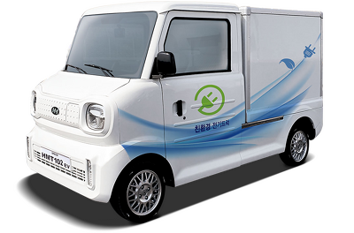
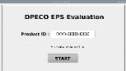
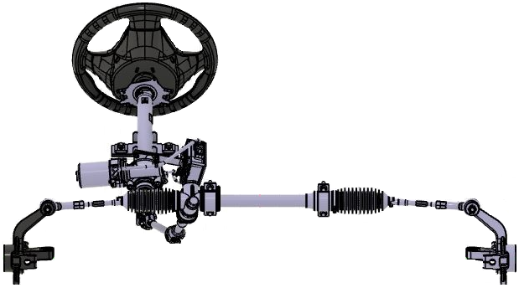
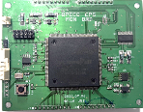
Entire System Configuration
데이터 수집 H/W + 신호처리 S/W w/ Jetson-Nano
③평가 및 검증 S/W
㈜디피코 EPS@실차
데이터수집
대상 / 센서
②신호처리 프로세서 H/W 모듈
- 차속 / CAN 통신 모니터링
- 조향변화 / TAS 출력 모니터링
- 모터 토크 / 토크 센서
- 모터 전류소모 / 전류 센서
.
.
.
SPD:±ΔΔ.Δ km/h
ANG:±ΔΔΔΔº
①데이터수집 H/W 모듈
TRQ:±ΔΔ.Δ N·m
10

Slide 11
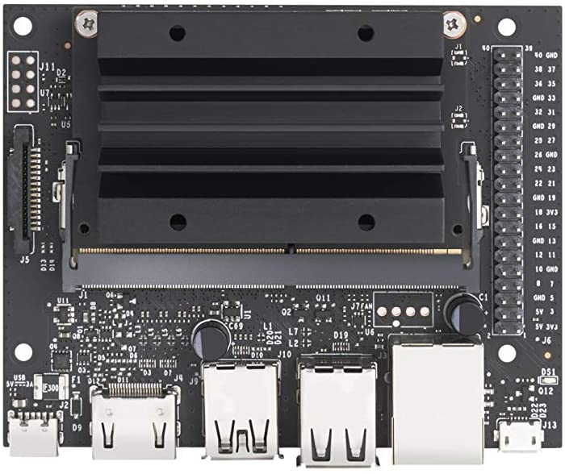
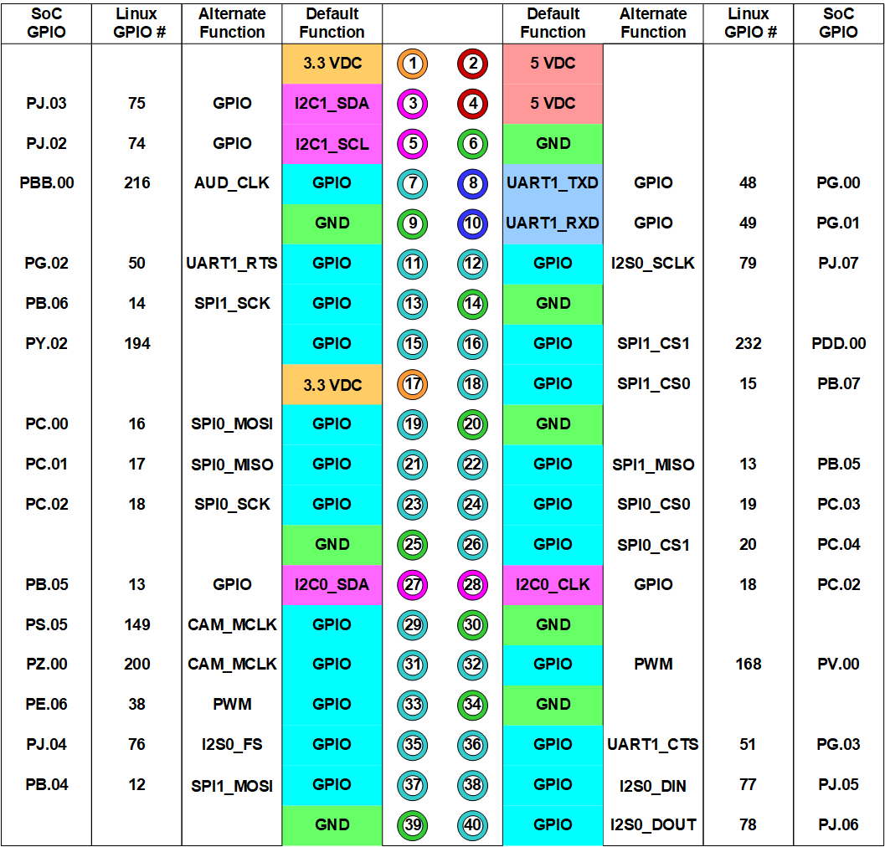
Interface : Data Mining H/W → Jetson-Nano
UART Serial Interface w/ ASCII Coding
: UART_RXD(Pin10)
11

Slide 12
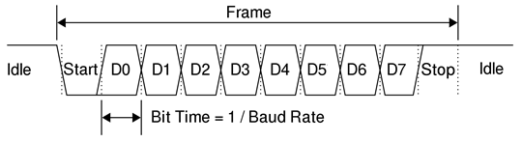
ASCII Protocol
Transfer Data (Baudrate: 57600bits/s, Transfer Interval:11.2332ms)
: Vehicle Speed / Handwheel Angle / Steering Torque
8’h34
8’h2E
8’h2B
8’h36
8’h35
“SPD:+46.5,ANG:+720,TRQ:+13.2^J”
8’h3A
8’h2C
8’h0A
8’h53
8’h44
8’h50
12

Slide 13
Data Mining H/W : FPGA PGM
Architecture w/ Input&Output
Top Module : EPS_DATA_MINING
RSTN
Module : CLOCK_GEN
CLK
(40MHz)
Input : CLK
Output : CLK_CAN, CLK_ADC, CLK_REG, CLK_UART
Module : CAN_IF
Module : DATA_REG
Input : CLK_CAN, CAN_EN
Output : CAN_DATA[7:0]
Input : CLK_REG,
CAN_DATA[7:0],
ADC_DATA[11:0]
Output : SPD[11:0], ANG[11:0],
TRQ[11:0]
CAN_RXD
(from CAN Transceiver)
(from ADS8688)
ADC_SDO
Module : ADC_CTRL
Input : CLK_ADC, ADC_SDO
Output : ADC_CSB, ADC_SCLK
ADC_SDI,
ADC_CH[1:0]
ADC_DATA[11:0]
Module : UART_IF
ADC_CSB,
ADC_SCLK,
ADC_SDI
(to ADS8688)
Input : CLK_UART, TEST_EN,
SPD[11:0], ANG[11:0],
TRQ[11:0]
Output : UART_TXD
UART_TXD
(to Jetson-Nano)
13

